Slide 1
CAD-IT IoT Centre NodeLinx Task Realtime Communication
V1.0 | 13 JUNE 2023
Didi Setiawan
IoT Application Engineer

Slide 2
Create a web application from chatting
Use MQTT as broker
No need database for storing message data (after browser reloaded, all data will reset)
Create chat app with following mockup (slide 4)
Show all user that registered in database for list user in sidebar
Try chat with open 2 browser and login difference account

Slide 3
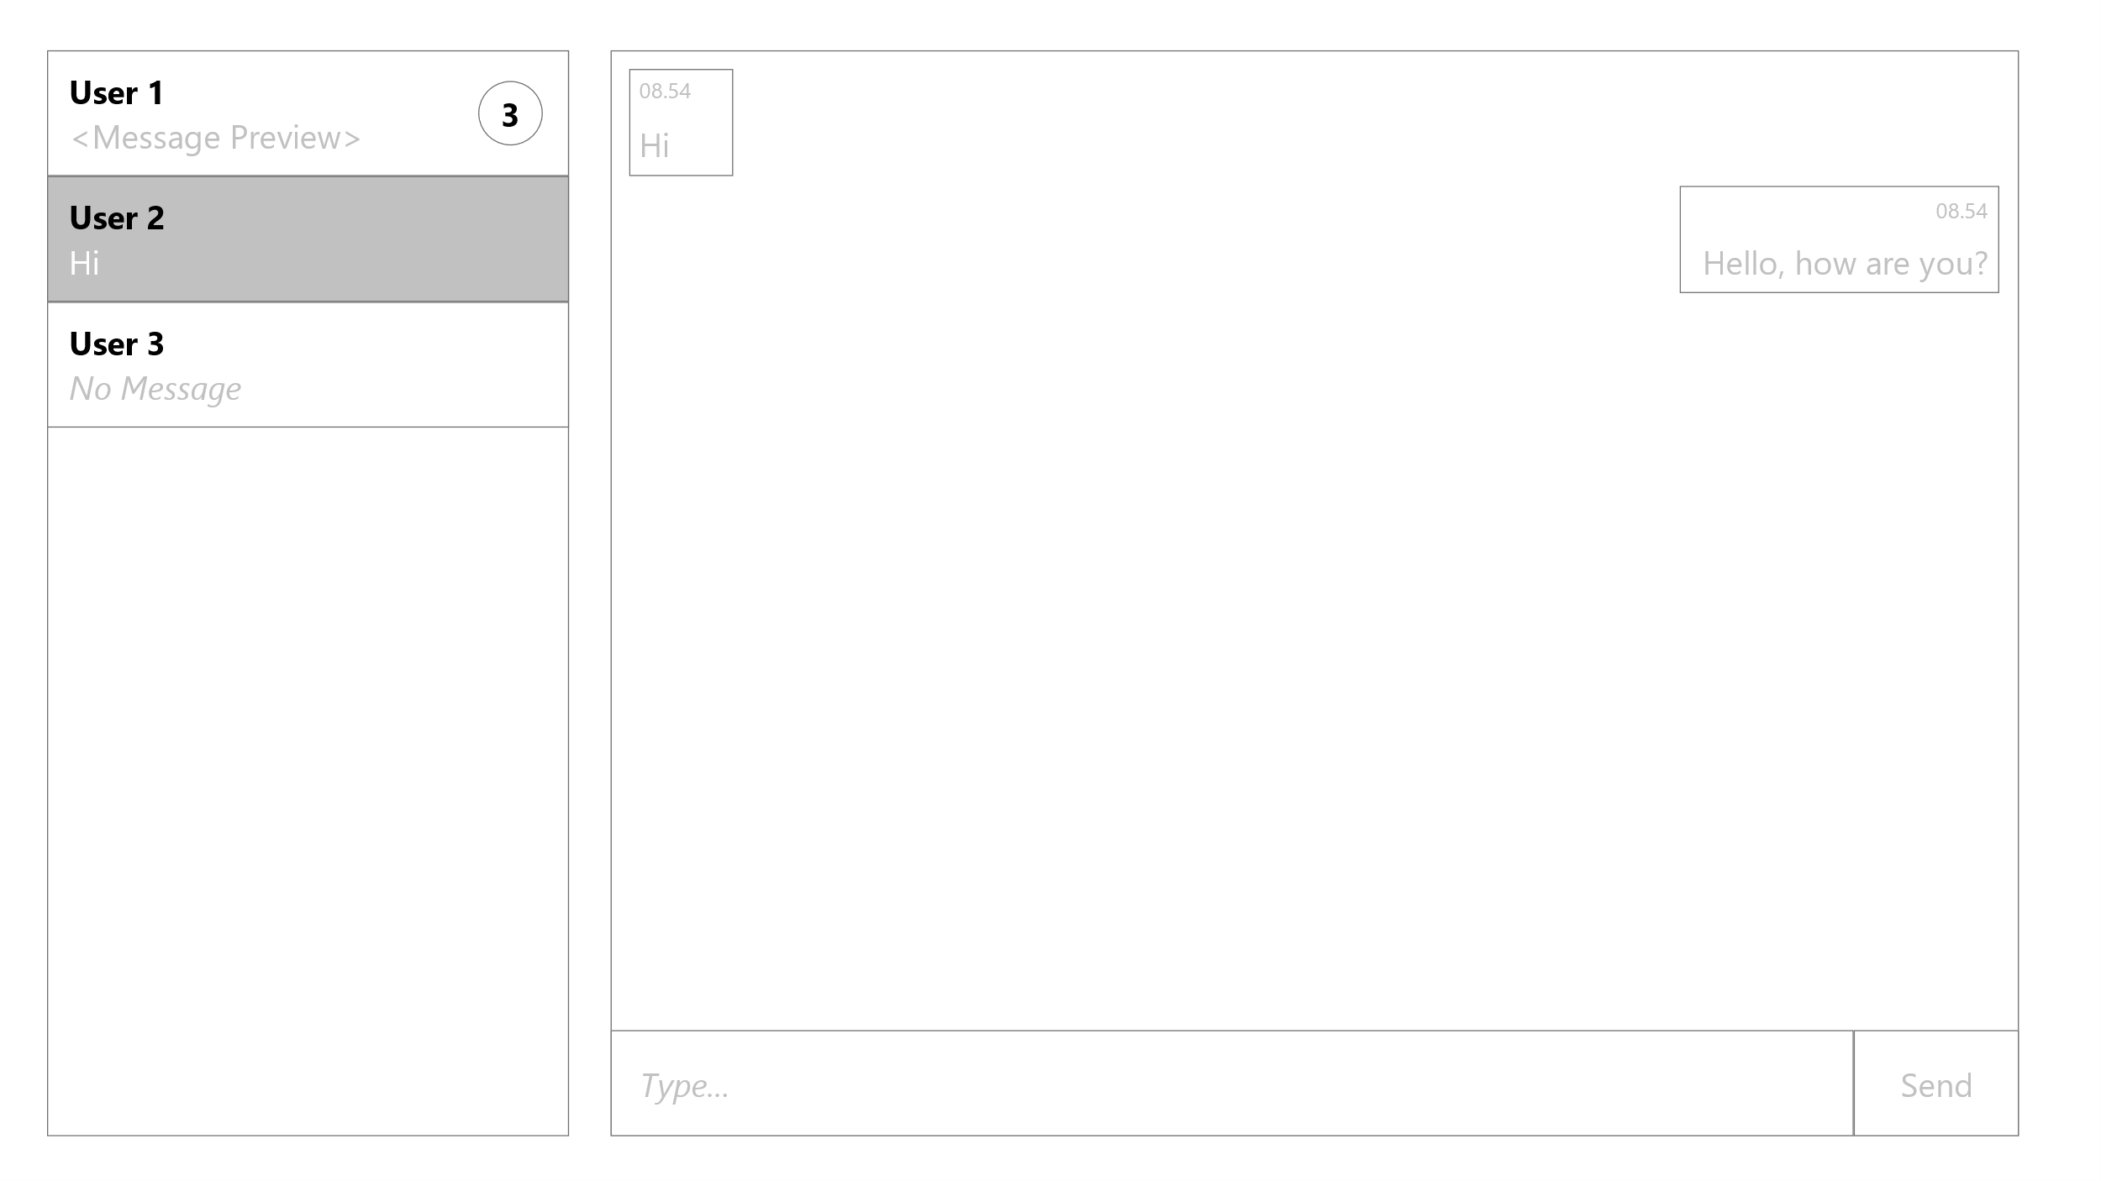
Mockup

